Slide 1
Lufthansa User Research
15.11.2017

Slide 2
Overview
Introduction
General Group Questions
Prototype Showcase
Interview on Prototype
Portal Task
General Discussion

Slide 3
Introduction

Slide 4
Introduction
Who we are..
What we are here to do..
Any issues in German

Slide 5
Group Questions

Slide 6
Group Questions
Have you ever used online methods to study a course previously?

Slide 7
Group Questions
If No...
Have you ever considered studying online?

Slide 8
Group Question
Why?

Slide 9
Group Questions
No?
What prevented you from studying online?

Slide 10
Group Questions
Yes?
What are your general thoughts on studying online?

Slide 11
Group Questions
What do you expect from the experience of studying courses online?

Slide 12
Group Questions
What would give you motivation to study online?

Slide 13
Group Questions
What demotivates you from studying online?

Slide 14
Group Questions
If You Have Studied Online
Where have you studied online before?

Slide 15
Group Questions
What was your experience like? Discuss.

Slide 16
Group Questions
What problems and frustrations come to mind from your experience?

Slide 17
Group Questions
What were the features you found most enjoyable?

Slide 18
Group Questions
How would you make the experience you had better for yourself?
(Consider your frustrations)
Discuss.

Slide 19
Group Questions
Where have you studied online before?

Slide 20
Prototype Showcase

Slide 21
Prototype 1

Slide 22
Prototype 1

Slide 23
Prototype 1

Slide 24
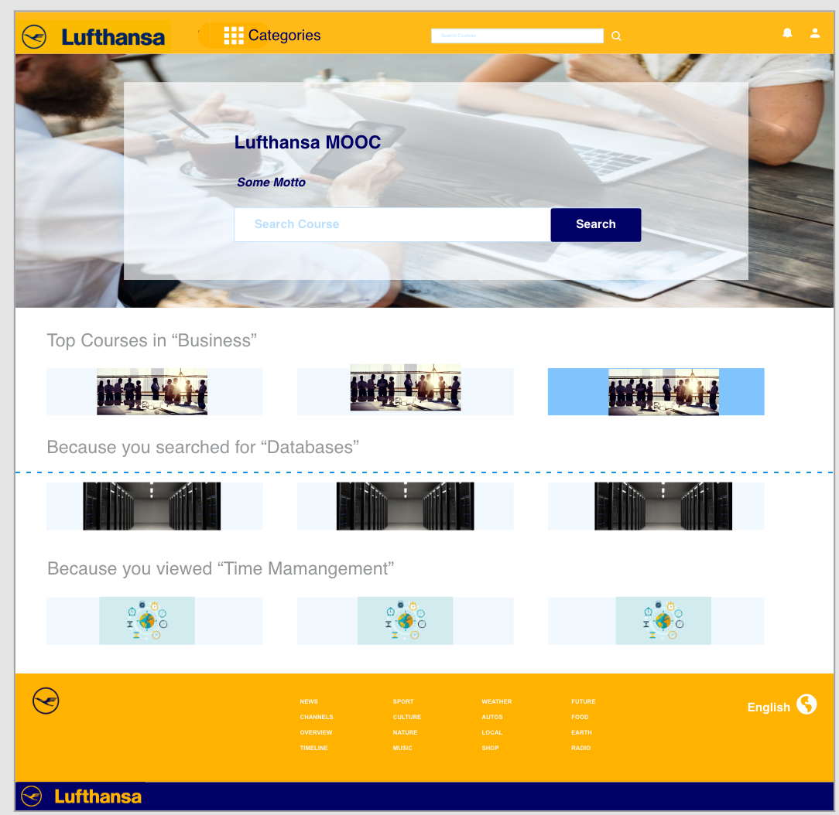
Prototype 2

Slide 25
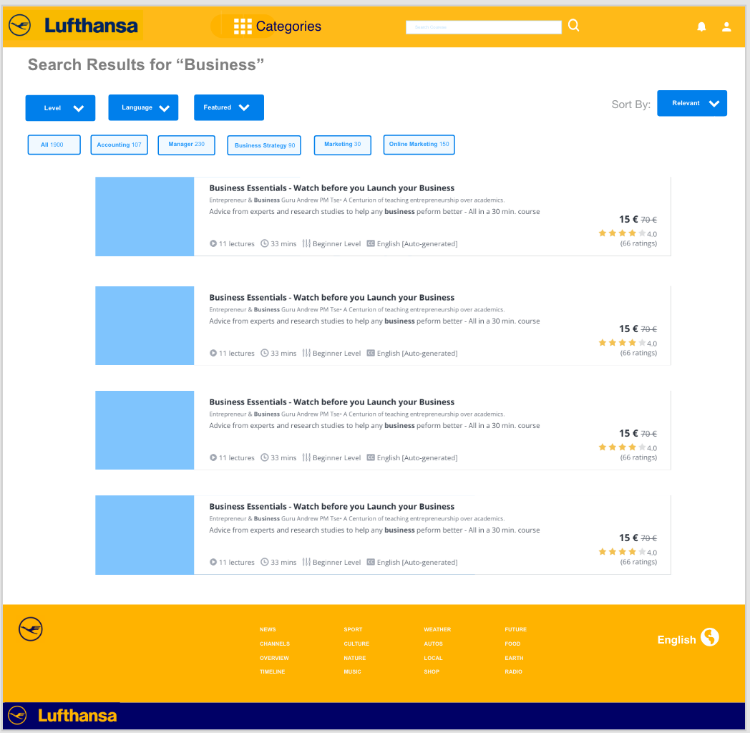
Prototype 2

Slide 26
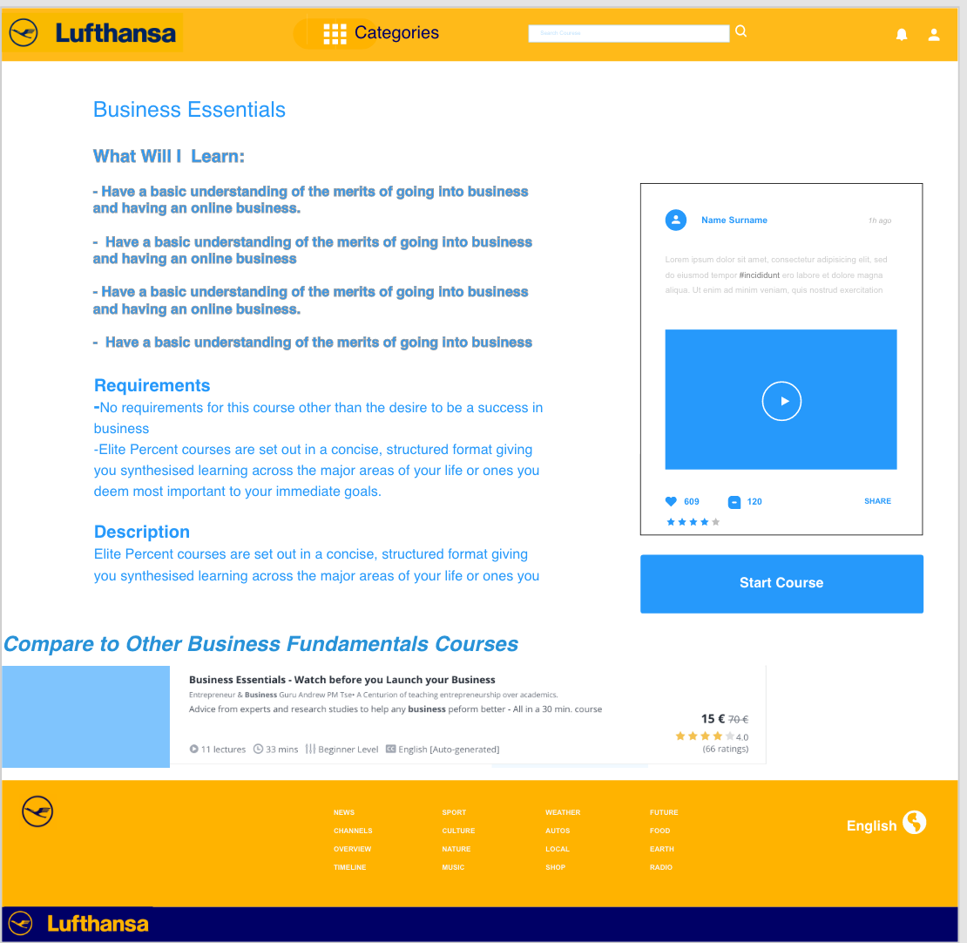
Prototype 2

Slide 27
Interview on Prototype

Slide 28
Portal Task

Slide 29
Thank you for your time

